Slide 1
Latent Analytics Pvt. Ltd.
Presented by
Sanjeev Ramasamy Seenivasagamani, Woojin Park, Xiaoyan Zhang, Jeet Ganatra, Christy Sato and Aniruddh Garge

Slide 2
Introduction
As an analytics solutions provider, we help airline companies make informed decisions with the help of our granular insights
Analyzing the survey responses and establishing the determining factors for the best customer satisfaction
Identifying the important business questions and answering them appropriately
Finding out the best predictors to increase customer satisfaction using various analytical models
Notes:
identifying the strongest correlating features that relate to customer overall satisfaction
exploring models to identify the most powerful warning features at a customer level.

Slide 3
Business Questions
How can airline companies improve customer satisfaction?
What are the characteristics (class, gender, and age) of customers who are most likely to rate satisfaction higher?
Notes:
I really don’t think there are so many business questions we are going to address. Based on my talk with professor in lab, the following three should not framed as independent business questions, actually they are parts of the first question. And first and second questions are basically asking the same question.
Is the class in which customers travel affecting the satisfaction rate?
Does the flight’s punctuality has an impact on the customer satisfaction?
Higher the Airline Status, higher the satisfaction? Is it true?

Slide 4
Solutions
Find good predictors for customer satisfaction (Linear Modeling).
Generate plots for significant variables and then perform analysis on how to have a higher satisfaction rate.
Segregate data that is Satisfied and not Satisfied (Support Vector Machines).
Sorting the evidence and making sense of it (Association Rules Algorithm).
Notes:
I really don’t think there are so many business questions we are going to address. Based on my talk with professor in lab, the following three should not framed as independent business questions, actually they are parts of the first question. And first and second questions are basically asking the same question.
Is the class in which customers travel affecting the satisfaction rate?
Does the flight’s punctuality has an impact on the customer satisfaction?
Higher the Airline Status, higher the satisfaction? Is it true?

Slide 5
Descriptive Statistics
Variable | Data Type | Description
Satisfaction | Numerical | Rated between 1-5 (5 means higher satisfied, and 1 is lowest level of satisfaction)
Airline Status | Categorical | Each customer has a different type of airline status which are platinum, gold, silver, or blue
Age | Numerical | Specific customer’s age, starting from 15 to 85 years old
Gender | Categorical | Female/Male
Price Sensitivity | Numerical | Grade to which the price affects customer’s purchasing (range between 0-5)
Year of First Flight | Numerical | First flight for each single customer ranging from 2003 to 2012
Number of Flights | Numerical | Number of flights that each customer has taken, range from 0-100
Type of Travel | Categorical | Three traveling purposes (business, mileage tickets based on loyalty cards, or personal travel)

Slide 6
Descriptive Statistics
Variable | Data Type | Description
Flight Cancelled | Categorical | If airline does not operate the flight
Flight time in minutes | Numerical | Period time to destination
Flight Distance | Numerical | Distance between destinations, ranging from 31 to 4983 minutes
Arrival Delay greater than 5 minutes | Categorical | Delay of arrival airline time, in which more than 5 minutes per each customer
Shopping Amount at Airport | Numerical | Three different kinds of service (business, economy plus, or economy)
Class | Categorical | Three different kinds of service (business, economy plus, or economy)

Slide 7
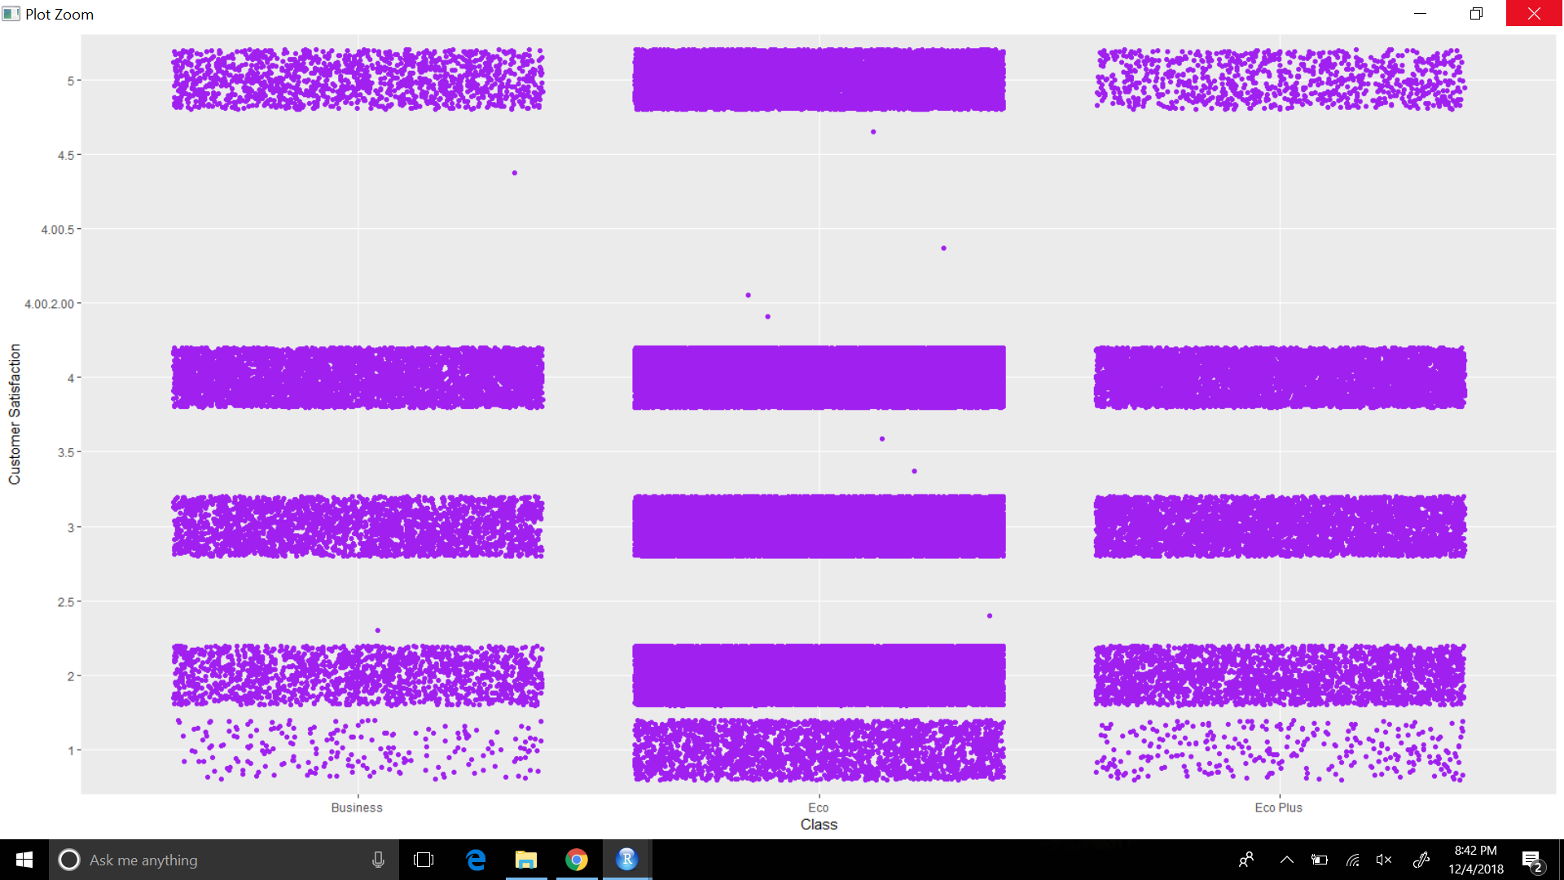
Variable Plots:
Class vs Customer Satisfaction

Slide 8
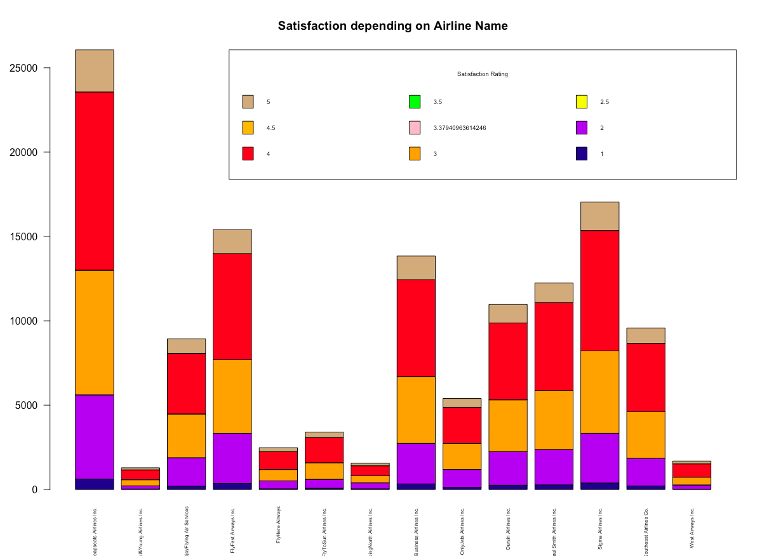
Variable Plots:
2. Airline Name vs Customer Satisfaction

Slide 9
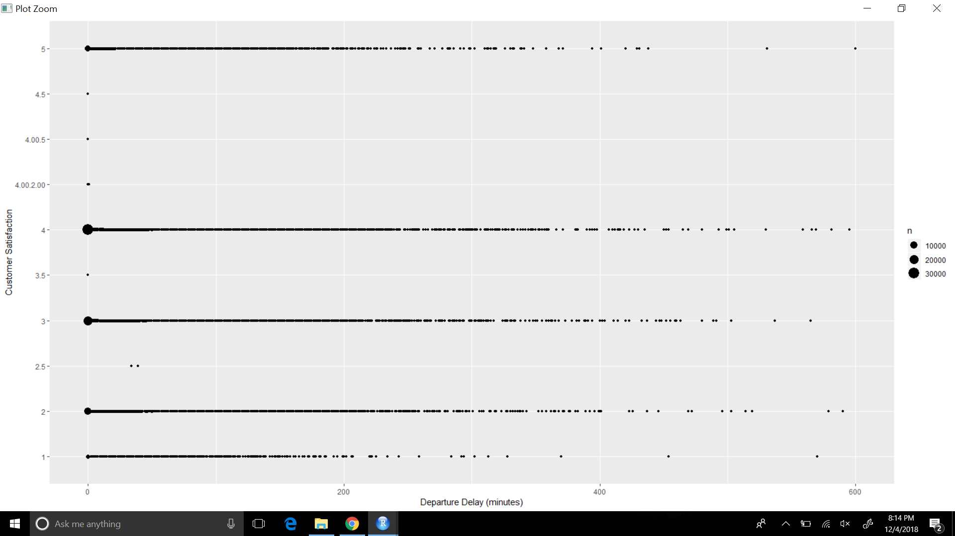
Variable Plots:
3. Departure Delay vs Customer Satisfaction

Slide 10
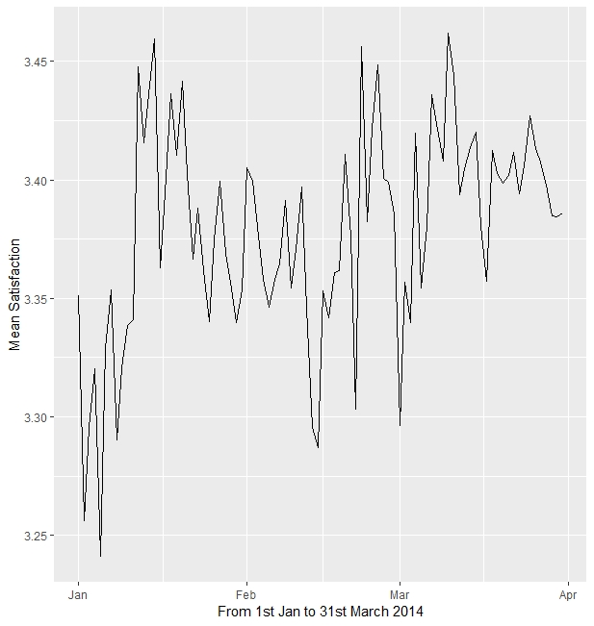
Variable Plots:
3. Flight Date vs Customer Satisfaction

Slide 11
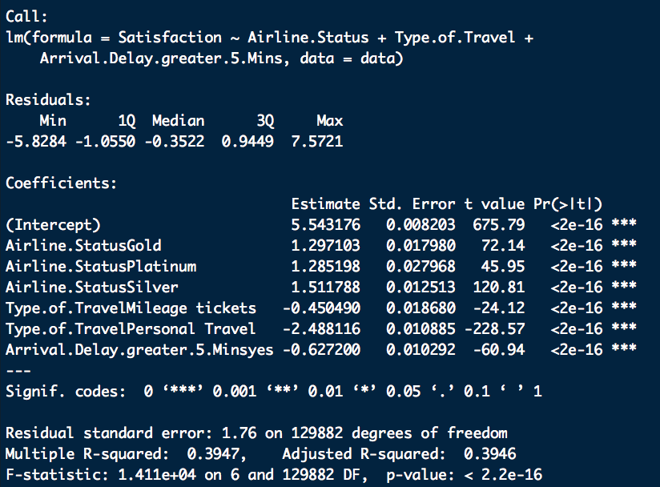
Linear Model

Slide 12
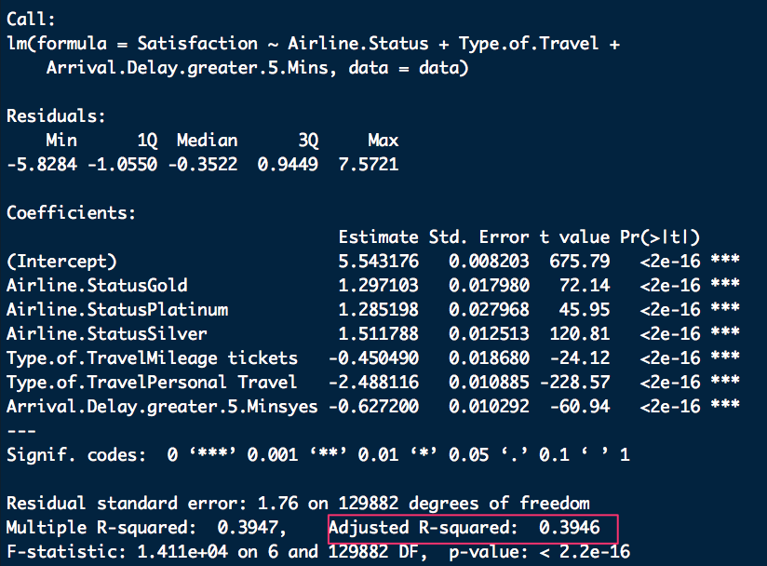
Linear Model

Slide 13
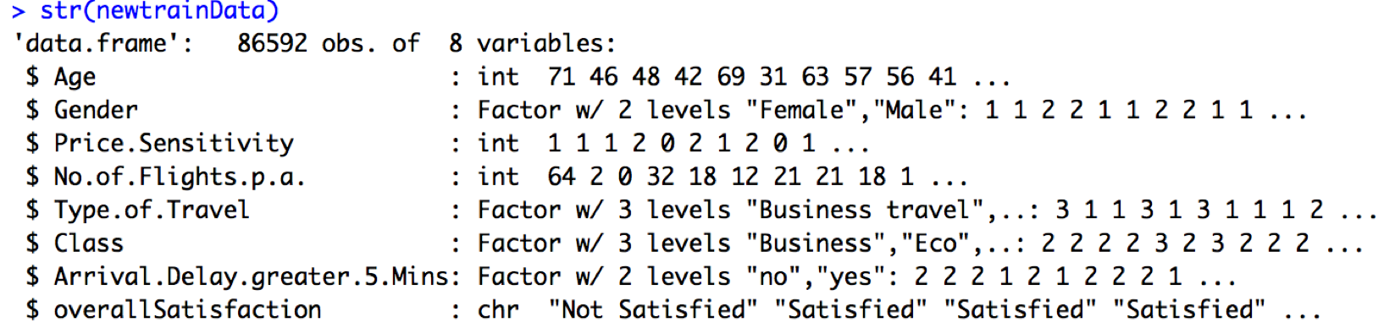
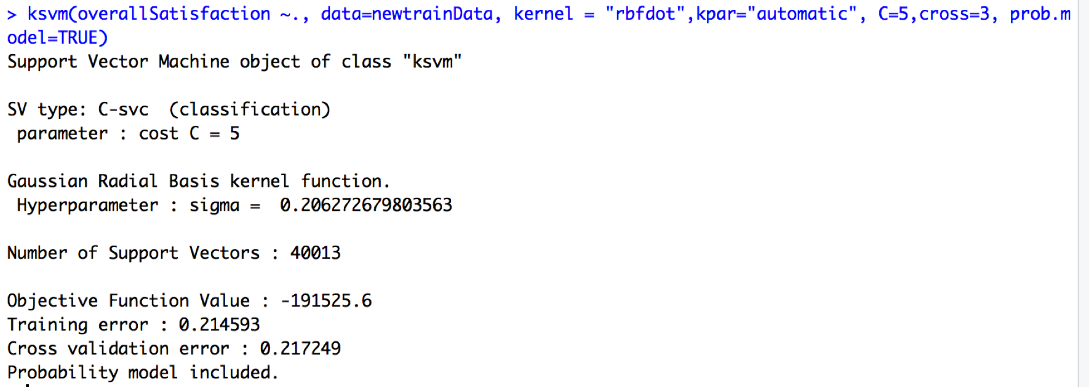
Support Vector Machine
Check Point
Percentage of confusion matrix group :Not Satisfied(49%), Satisfied(51%)
This model enable to predict almost with 80% accuracy
Interesting finding : Overall error rate is 0.24%
But, when we compare the error rate of two groups
Satisfied group Error rate : 2563/(19568+2563) = 0.11%
Not Satisfied group Error rate : 7693/(7693+13473) = 0.36 %
Better accuracy(89%) to distinguish ‘Satisfied’ customers (*Not Satisfied 64%)
Notes:
Too many words on slide

Slide 14
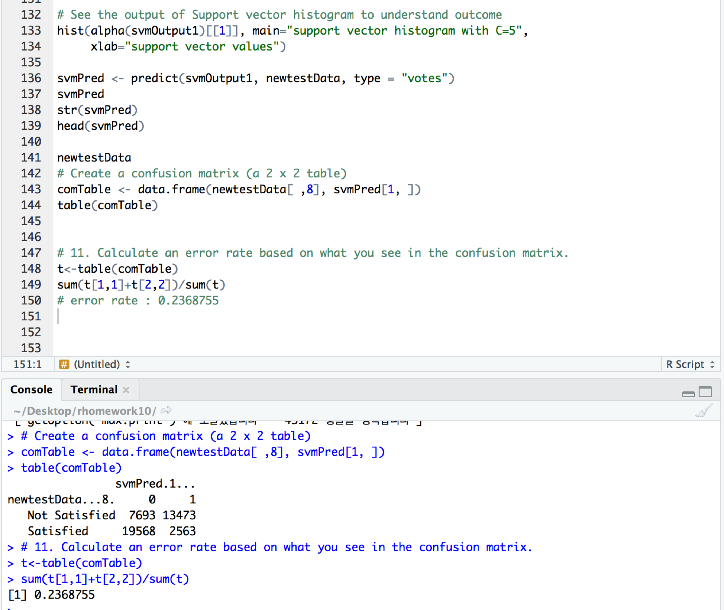
Support Vector Machine
Lesson-learned
SVM is very good when we have no idea on the data
Also it has a regularisation parameter (finding optimal margin) to avoid over-fitting or under-fitting problem
Need to be patient while building SVMs on large datasets, they take a lot of time for training

Slide 15
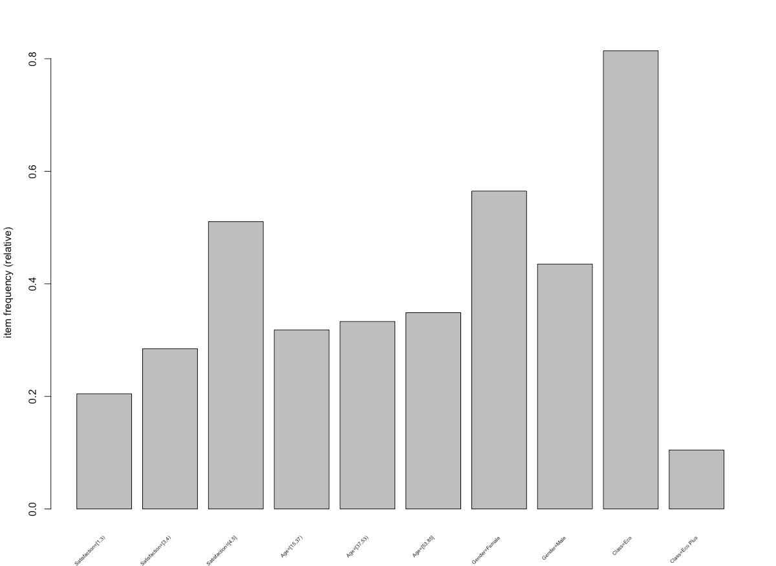
Association Rules Mining
Class [Economy]
Gender [Females]
Satisfaction [4,5]
Age [53,85]

Slide 16
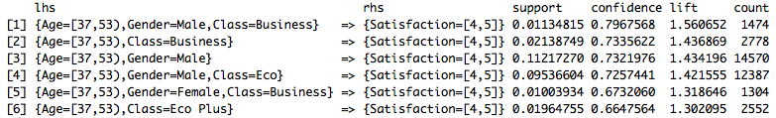
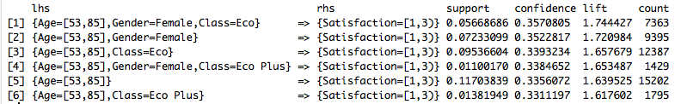
Association Rules Mining
High Satisfaction Ratings
Low Satisfaction Ratings
Notes:
Strategy: be more mindful of elderly females in economy class

Slide 17
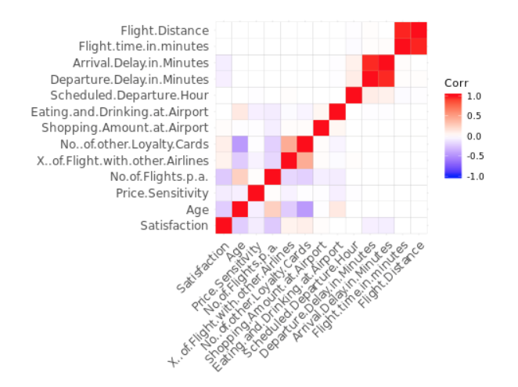
Bivariate Correlation
Notes:
?

Slide 18
Logistic Regression
The dependent variable is converted into a categorical variable based on its value
If the Satisfaction rate is greater than 3, a value of 1 is assigned to the new ‘Sat’ categorical else 0
The continuous version of the Satisfaction variable is removed from the dataset
To check the variable significance, we run the logistic regression model on the dataset and remove few insignificant variables
The data is split into train & test dataset and the former is used to train the model
K-fold cross validation is used to validate the model with k=10
Notes:
You don’t have to explain how you did it. We are assuming that the audiences we are presenting to are airline managers or whoever is interested in improving satisfaction. They care about the results. What can they do?

Slide 19
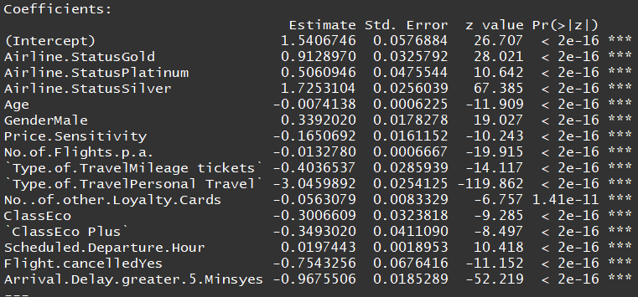
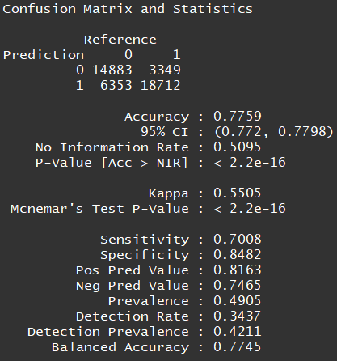
Logistic Regression (cont.)

Slide 20
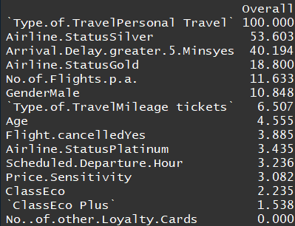
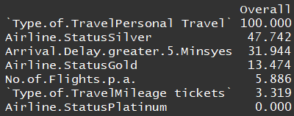
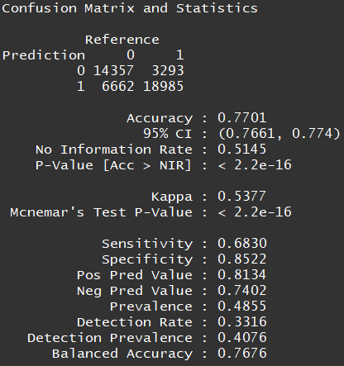
Logistic Regression (cont.)

Slide 21
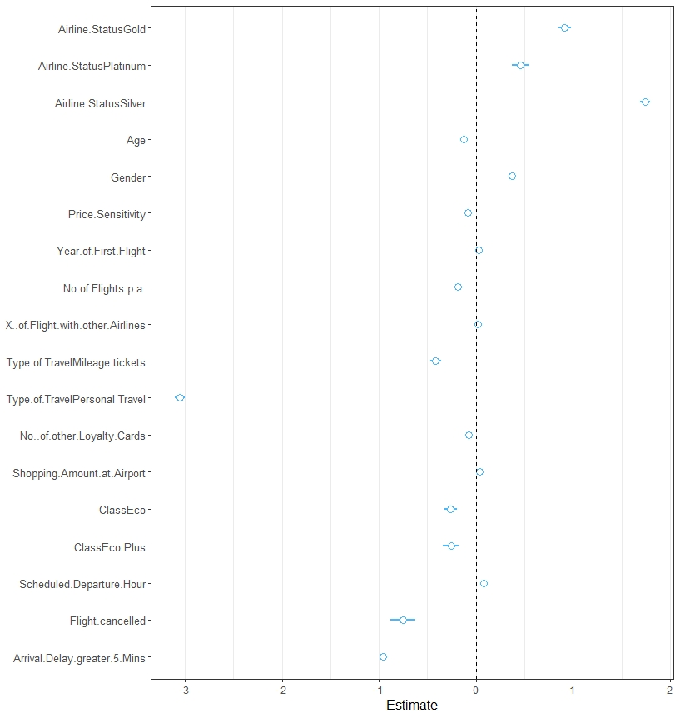
Logistic Regression (cont.)

Slide 22
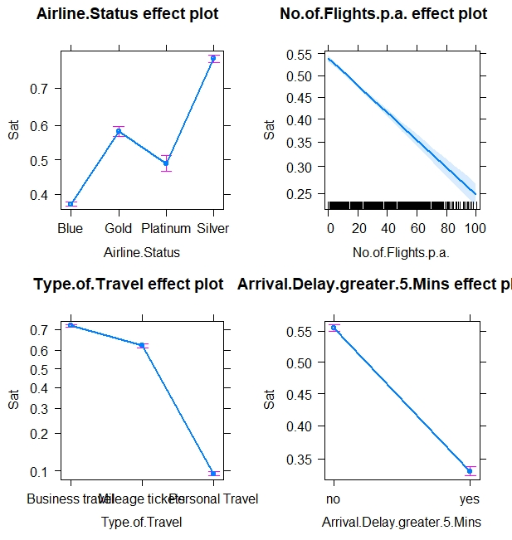
Logistic Regression (cont.)

Slide 23
Final Conclusions
Create a strategy to improve overall customer satisfaction within women between the ages of 53 to 85 that are flying in the economy class.
The class in which the customers travel are significant but not the deciding factor.
Gender plays a significant role in determining the customer’s satisfaction.
Lower the delay, higher the customer satisfaction.
Airline Status - Silver has been predicted to have the highest satisfaction rate followed by Gold.

Slide 24
Thank you.

